Slide 1
Data Communication CSE 317
Notes:
“Data and Computer Communications”, 10/e, by William Stallings, Chapter 1 “Data Communications, Data Networks, and the Internet”.

Slide 2
Data Communications, Data Networks, and the Internet
Introduction
Notes:
This book aims to provide a unified view of the broad field of data and computer
communications. The organization of the book reflects an attempt to
break this massive subject into comprehensible parts and to build, piece by
piece, a survey of the state of the art. This introductory chapter begins with a
general model of communications.

Slide 3
“The fundamental problem of communication is that of reproducing at one point either exactly or approximately a message selected at another point”
- The Mathematical Theory of Communication,
Claude Shannon
Notes:
Effective and efficient data communication and networking facilities are vital to any
enterprise. In this section, we first look at trends that are increasing the challenge for
the business manager in planning and managing such facilities. Then we look specifically
at the requirement for ever-greater transmission speeds and network capacity

Slide 4
Technological Advancement Driving Forces
Traffic growth at a high and steady rate
Advances in technology
Development of new services
Notes:
Three different forces have consistently driven the architecture and evolution of
data communications and networking facilities: traffic growth, development of new
services, and advances in technology.
Communication traffic , both local (within a building or business campus) and
long distance, has been growing at a high and steady rate for decades. Network traffic
is no longer limited to voice and data and increasingly includes image and video.
Increasing business emphasis on web services, remote access, online transactions,
and social networking means that this trend is likely to continue. Thus, business
managers are constantly pressured to increase communication capacity in cost-effective
ways.
As businesses rely more and more on information technology, the range of
services that business users desire to consume is expanding. For example, mobile
broadband traffic growth is exploding as is the amount of data being pushed over
mobile networks by business users’ smart phones and tablets. In addition, over
time, mobile users are increasingly demanding high-quality services to support their
high-resolution camera phones, favorite video streams, and high-end audio. Similar
demand growth is seen in landline access to the Internet and private networks. To
keep up with mushrooming traffic generated by both consumers and business users,
mobile service providers have to keep investing in high-capacity networking and
transmission facilities. In turn, the growth in high-speed network offerings at competitive
price points encourages the expansion of mobile applications and services.
Thus, growth in services and in traffic capacity go hand in hand.

Slide 5
Notes:
As an example, Figure 1.1 [IEEE12] shows the mix of traffic and the growth trend for cable Internet
subscribers.

Slide 6
Notable Trends(bs:31)
Trend toward faster and cheaper, in both computing and communication
More powerful computers supporting more demanding applications
The increasing use of optical fiber and high-speed wireless has brought transmission prices down and greatly increased capacity
Today’s networks are more “intelligent”
Differing levels of quality of service (QoS)
Variety of customizable services in the areas of network management and security
The Internet, the Web, and associated applications have emerged as dominant features for both business and personal network landscapes
“Everything over IP”
Intranets and extranets are being used to isolate proprietary information
Mobility
iPhone, Droid, and iPad have become drivers of the evolution of business networks and their use
Enterprise applications are now routinely delivered on mobile devices
Cloud computing is being embraced
Notes:
Finally, trends in technology enable the provision of increasing traffic capacity
and the support of a wide range of services. Four technology trends are particularly
notable:
1. The trend toward faster and cheaper, in both computing and communications,
continues. In terms of computing, this means more powerful computers and
clusters of computers capable of supporting more demanding applications, such
as multimedia applications. In terms of communications, the increasing use of
optical fiber and high-speed wireless has brought transmission prices down and
greatly increased capacity. For example, for long-distance telecommunication
and data network links, dense wavelength division multiplexing (DWDM)
enables communication traffic to be carried by fiber optic cables at rates of
multiple terabits per second. For local area networks (LANs), many enterprises
now have 40-Gbps Ethernet or 100-Gbps Ethernet backbone networks.
2. Today’s networks are more “intelligent” than ever. Two areas of intelligence
are noteworthy. First, today’s networks can offer differing levels of quality
of service (QoS), which include specifications for maximum delay, minimum
throughput, and so on to ensure high-quality support for applications and services.
Second, today’s networks provide a variety of customizable services in
the areas of network management and security.
3. The Internet, the Web, and associated applications have emerged as dominant
features for both business and personal network landscapes. The migration
to “everything over IP” continues and has created many opportunities and
challenges for information and communications technology (ICT) managers.
In addition to exploiting the Internet and the Web to reach customers, suppliers,
and partners enterprises have formed intranets and extranets to isolate
proprietary information to keep it free from unwanted access.
4. Mobility is newest frontier for ICT managers, and popular consumer devices
such as the iPhone, Droid, and iPad have become drivers of the evolution of
business networks and their use. While there has been a trend toward mobility
for decades, the mobility explosion has occurred and has liberated workers
from the confines of the physical enterprise. Enterprise applications traditionally
supported on terminals and office desktop computers are now routinely
delivered on mobile devices. Cloud computing is being embraced by all
major business software vendors including SAP, Oracle, and Microsoft, and
this ensures that further mobility innovations will be forthcoming. Industry
experts predict that mobile devices will become the dominant business computing
platform by 2015 and that enhanced ability to use enterprise information
resources and services anywhere-anytime will be a dominant trend for the
remainder of the decade.

Slide 7
Notes:
Figure 1.2 [IEEE12] indicates the Ethernet demand trend. As shown, usage
statistics indicate that Internet backbone data rate demand in the network
Core doubles approximately every 18 months, while demand in enterprise/LAN
Applications doubles approximately every 24 months.

Slide 8

Changes in Networking Technology(BS:33)
* Emergence of high-speed LANs
* Corporate WAN needs
* Digital electronics
Notes:
Momentous changes in the way organizations do business and process information
have been driven by changes in networking technology and at the same time have
driven those changes. It is hard to separate chicken and egg in this field. Similarly,
the use of the Internet by both businesses and individuals reflects this cyclic dependency:
The availability of new image-based services on the Internet (i.e., the Web)
has resulted in an increase in the total number of users and the traffic volume generated
by each user. This, in turn, has resulted in a need to increase the speed and
efficiency of the Internet. On the other hand, it is only such increased speed that
makes the use of Web-based applications palatable to the end user.

Slide 9
Emergence of High-Speed LANs
Personal computers and microcomputer workstations have become an essential tool for office workers
Examples of requirements that call for higher-speed LANs:
Centralized server farms
Power workgroups
High-speed local backbone
Two significant trends altered the requirements of the LAN
Explosive growth of speed and computing power of personal computers
LANs have been recognized as a viable and essential computing platform
Notes:
Personal computers and microcomputer
workstations began to achieve widespread acceptance in business computing in the
early 1980s and have now achieved virtually the status of the telephone: an essential
tool for office workers. Until relatively recently, office LANs provided basic
connectivity services—connecting personal computers and terminals to mainframes
and midrange systems that ran corporate applications, and providing workgroup
connectivity at the departmental or divisional level. In both cases, traffic patterns
were relatively light, with an emphasis on file transfer and electronic mail. The
LANs that were available for this type of workload, primarily Ethernet and token
ring, are well suited to this environment.
In the last 20 years, two significant trends altered the role of the personal computer
and therefore the requirements on the LAN:
1. The speed and computing power of personal computers continued to enjoy
explosive growth. These more powerful platforms support graphics-intensive
applications and ever more elaborate graphical user interfaces to the operating
system.
2. MIS (management information systems) organizations have recognized the
LAN as a viable and essential computing platform, resulting in the focus on
network computing. This trend began with client/server computing, which has
become a dominant architecture in the business environment and the more
recent Web-focused intranet trend. Both of these approaches involve the frequent
transfer of potentially large volumes of data in a transaction-oriented
environment.
The effect of these trends has been to increase the volume of data to be handled
over LANs and, because applications are more interactive, to reduce the acceptable
delay on data transfers. The earlier generation of 10-Mbps Ethernets and 16-Mbps
token rings was simply not up to the job of supporting these requirements.
The following are examples of requirements that call for higher-speed LANs:
• Centralized server farms: In many applications, there is a need for user, or
client, systems to be able to draw huge amounts of data from multiple centralized
servers, called server farms. An example is a color publishing operation,
in which servers typically contain tens of gigabytes of image data that must
be downloaded to imaging workstations. As the performance of the servers
themselves has increased, the bottleneck has shifted to the network.
• Power workgroups: These groups typically consist of a small number of
cooperating users who need to draw massive data files across the network.
Examples are a software development group that runs tests on a new software
version, or a computer-aided design (CAD) company that regularly runs simulations
of new designs. In such cases, large amounts of data are distributed to
several workstations, processed, and updated at very high speed for multiple
iterations.
• High-speed local backbone: As processing demand grows, LANs proliferate
at a site, and high-speed interconnection is necessary.

Slide 10
Corporate Wide Area Networking Needs
Changes in corporate data traffic patterns are driving the creation of high-speed WANs
Growing use of telecommuting
Nature of the application structure has changed
Intranet computing
More reliance on personal computers, workstations, and servers
More data-intensive applications
Most organizations require access to the Internet
Traffic patterns have become more unpredictable
Average traffic load has risen
More data is transported off premises and into the wide area
Notes:
As recently as the early 1990s, there was an emphasis in many organizations on a centralized data processing model. In a
typical environment, there might be significant computing facilities at a few regional
offices, consisting of mainframes or well-equipped midrange systems. These centralized
facilities could handle most corporate applications, including basic finance,
accounting, and personnel programs, as well as many of the business-specific applications.
Smaller, outlying offices (e.g., a bank branch) could be equipped with
terminals or basic personal computers linked to one of the regional centers in a
transaction-oriented environment.
This model began to change in the early 1990s, and the change accelerated
since then. Many organizations have dispersed their employees into multiple smaller
offices. There is a growing use of telecommuting. Most significant, the nature of
the application structure has changed. First client/server computing and, more
recently, intranet computing have fundamentally restructured the organizational
data processing environment. There is now much more reliance on personal computers,
workstations, and servers and much less use of centralized mainframe and
midrange systems. Furthermore, the virtually universal deployment of graphical
user interfaces to the desktop enables the end user to exploit graphic applications,
multimedia, and other data-intensive applications. In addition, most organizations
require access to the Internet. When a few clicks of the mouse can trigger huge volumes
of data, traffic patterns have become more unpredictable while the average
load has risen.
All of these trends mean that more data must be transported off premises and
into the wide area. It has long been accepted that in the typical business environment,
about 80% of the traffic remains local and about 20% traverses wide area
links. But this rule no longer applies to most companies, with a greater percentage
of the traffic going into the WAN environment. This traffic flow shift places a
greater burden on LAN backbones and, of course, on the WAN facilities used by a
corporation. Thus, just as in the local area, changes in corporate data traffic patterns
are driving the creation of high-speed WANs.

Slide 11
Digital Electronics
The rapid conversion of consumer electronics to digital technology is having an impact on both the Internet and corporate intranets
Image and video traffic carried by networks is dramatically increasing
Because of their huge storage capacity digital versatile disks (DVDs) are being incorporated into Web sites
Digital camcorders have made it easier to make digital video files to be placed on corporate and Internet Web sites
Notes:
The rapid conversion of consumer electronics to digital
technology is having an impact on both the Internet and corporate intranets. As
these new gadgets come into view and proliferate, they dramatically increase the
amount of image and video traffic carried by networks.
Two noteworthy examples of this trend are digital versatile disks (DVDs)
and digital still cameras. With the capacious DVD, the electronics industry at last
found an acceptable replacement for the analog video home system (VHS) tapes.
The DVD has replaced the videotape used in videocassette recorders (VCRs) and
the CD-ROM in personal computers and servers. The DVD takes video into the
digital age. It delivers movies with picture quality that outshines laser disks, and it
can be randomly accessed like audio CDs, which DVD machines can also play. Vast
volumes of data can be crammed onto the disk. With DVD’s huge storage capacity
and vivid quality, PC games have become more realistic and educational software
incorporates more video. Following in the wake of these developments is a new
crest of traffic over the Internet and corporate intranets, as this material is incorporated
into Web sites.
A related product development is the digital camcorder. This product has
made it easier for individuals and companies to make digital video files to be placed
on corporate and Internet Web sites, again adding to the traffic burden.

Slide 12
Convergence(Comment)
The merger of previously distinct telephony and information technologies and markets
Involves:
Moving voice into a data infrastructure
Integrating all the voice and data networks inside a user organization into a single data network infrastructure
Then extending that into the wireless arena
Applications
These are seen by the end users
Enterprise services
Services the information network supplies to support applications
Infrastructure
Communication links available to the enterprise
Layers:
Foundation is packet-based transmission using the Internet Protocol (IP) Increases the function and scope of both the infrastructure and the application base
Notes:
Convergence refers to the merger of previously distinct telephony and information
technologies and markets. We can think of this convergence in terms of a three-layer
model of enterprise communications:
• Applications: These are seen by the end users of a business. Convergence
integrates communications applications, such as voice calling (telephone),
voice mail, e-mail, and instant messaging, with business applications, such
as workgroup collaboration, customer relationship management, and other
back-office functions. With convergence, applications provide features that
incorporate voice, data, and video in a seamless, organized, and value-added
manner. One example is multimedia messaging, which enables a user to
employ a single interface to access messages from a variety of sources (e.g.,
office voice mail, office e-mail, beeper, and fax).
• Enterprise services: At this level, the manager deals with the information
network in terms of the services it provides to support applications. The network
manager needs design, maintenance, and support services related to the
deployment of convergence-based facilities. Also at this level, network managers
deal with the enterprise network as a function-providing system. Such
management services may include setting up authentication schemes; capacity
management for various users, groups, and applications; and QoS provision.
• Infrastructure: The network and communications infrastructure consists
of the communication links, LANs, WANs, and Internet connections available
to the enterprise. Increasingly, enterprise network infrastructure also
includes private and/or public cloud connections to data centers which host
high-volume data storage and Web services. A key aspect of convergence at
this level is the ability to carry voice, image, and video over networks that
were originally designed to carry data traffic. Infrastructure convergence has
also occurred for networks that were designed for voice traffic. For example,
video, image, text, and data are routinely delivered to smart phone users over
cell phone networks.
In simple terms, convergence involves moving voice into a data infrastructure,
integrating all the voice and data networks inside a user organization into a
single data network infrastructure, and then extending that into the wireless arena.
The foundation of this convergence is packet-based transmission using the Internet
Protocol (IP). Convergence increases the function and scope of both the infrastructure
and the application base.

Slide 13
DATA COMMUNICATIONS
The term telecommunication means communication at a distance. The word data refers to information presented in whatever form is agreed upon by the parties creating and using the data. Data communications are the exchange of data between two devices via some form of transmission medium such as a wire cable.
Topics discussed in this section:
Components of a data communications system
Data Flow

Slide 14
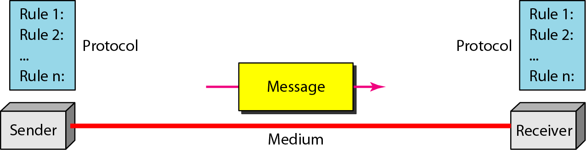
Figure Components of a data communication system

Slide 15
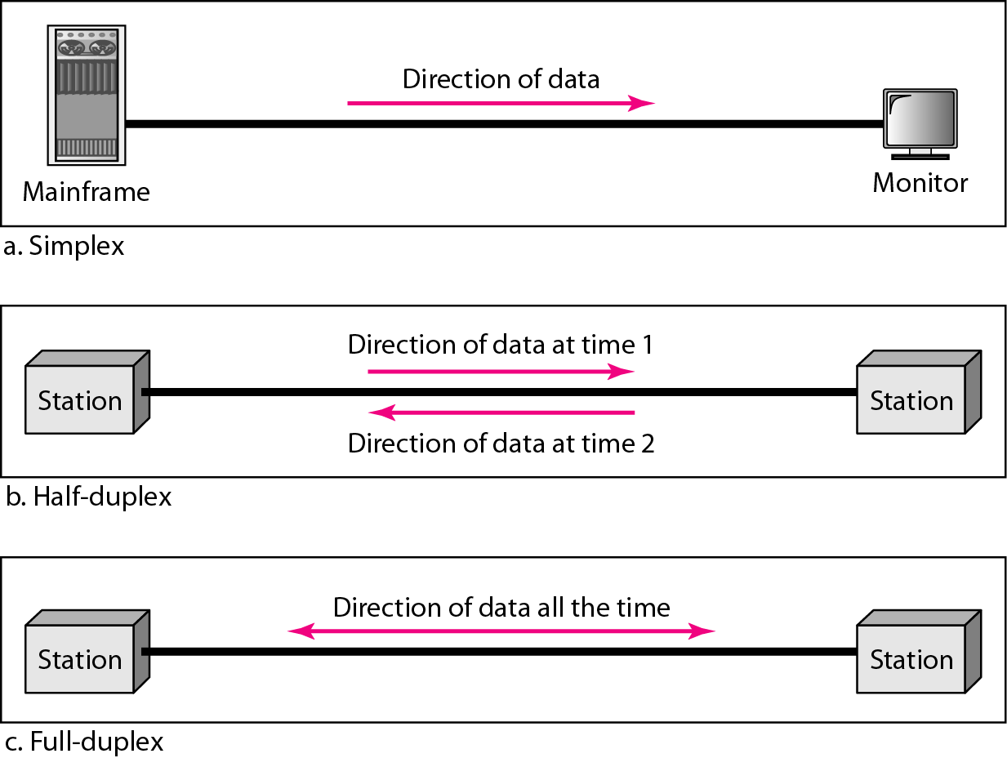
Figure 1.2 Data flow (simplex, half-duplex, and full-duplex)

Slide 16
Notes:
This section introduces a simple model of communications, illustrated by the block
diagram in Figure 1.3a.
The fundamental purpose of a communications system is the exchange of data
between two parties. Figure 1.3b presents one particular example, which is communication
between a workstation and a server over a public telephone network.
Another example is the exchange of voice signals between two telephones over the
same network. The following are key elements of the model:
• Source: This device generates the data to be transmitted; examples are telephones
and personal computers.
• Transmitter: Usually, the data generated by a source system are not transmitted
directly in the form in which they were generated. Rather, a transmitter
transforms and encodes the information in such a way as to produce electromagnetic
signals that can be transmitted across some sort of transmission system.
For example, a modem takes a digital bit stream from an attached device such
as a personal computer and transforms that bit stream into an analog
signal that can be handled by the telephone network.
• Receiver: The receiver accepts the signal from the transmission system and
converts it into a form that can be handled by the destination device. For
example, a modem will accept an analog signal coming from a network or
transmission line and convert it into a digital bit stream.
• Destination: Takes the incoming data from the receiver.
• Transmission system: This can be a single transmission line or a complex network
connecting source and destination.
• Receiver: The receiver accepts the signal from the transmission system and
converts it into a form that can be handled by the destination device. For
example, a modem will accept an analog signal coming from a network or
transmission line and convert it into a digital bit stream.
• Destination: Takes the incoming data from the receiver.

Slide 17
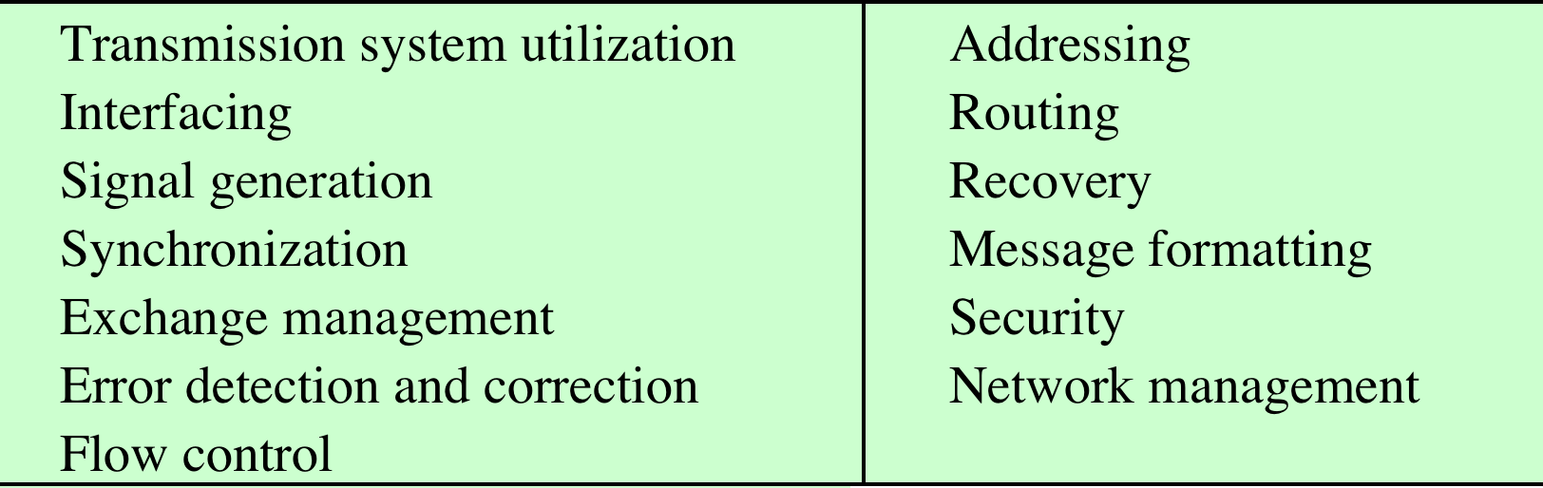
Table 1.1 Communications Tasks(BS:36)
Notes:
This simple narrative conceals a wealth of technical complexity. To get some
idea of the scope of this complexity, Table 1.1 lists some of the key tasks that must
be performed in a data communications system. The list is somewhat arbitrary:
Elements could be added; items on the list could be merged; and some items represent
several tasks that are performed at different “levels” of the system. However,
the list as it stands is suggestive of the scope of this book.
The first item, transmission system utilization , refers to the need to make
efficient use of transmission facilities that are typically shared among a number of
communicating devices. Various techniques (referred to as multiplexing) are used
to allocate the total capacity of a transmission medium among a number of users.
Congestion control techniques may be required to assure that the system is not
overwhelmed by excessive demand for transmission services.
To communicate, a device must interface with the transmission system. All
forms of communication discussed in this book depend on the use of electromagnetic
signals propagated over a transmission medium. Thus, once an interface is
established, signal generation is required for communication. The properties of the
signal, such as form and intensity, must be such that the signal is (1) capable of
being propagated through the transmission system, and (2) interpretable as data at
the receiver.
Not only must the signals be generated to conform to the requirements of the
transmission system and receiver, but also there must be some form of synchronization
between transmitter and receiver. The receiver must be able to determine
when a signal begins to arrive and when it ends. It must also know the duration of
each signal element.
Beyond the basic matter of deciding on the nature and timing of signals, there
is a variety of requirements for communication between two parties that might be
collected under the term exchange management . If data are to be exchanged in both
directions over a period of time, the two parties must cooperate. For example, for
two parties to engage in a telephone conversation, one party must dial the number
of the other, causing signals to be generated that result in the ringing of the called
phone. The called party completes a connection by lifting the receiver. For data processing
devices, more will be needed than simply establishing a connection; certain
conventions must be decided on. These conventions might include whether both
devices may transmit simultaneously or must take turns, the amount of data to be
sent at one time, the format of the data, and what to do if certain contingencies such
as an error arise.
The next two items might have been included under exchange management,
but they seem important enough to list separately. In all communications systems,
there is a potential for error; transmitted signals are distorted to some extent before
reaching their destination. Error detection and correction are required in circumstances
where errors cannot be tolerated. This is usually the case with data processing
systems. For example, in transferring a file from one computer to another, it is
simply not acceptable for the contents of the file to be accidentally altered. Flow
control is required to assure that the source does not overwhelm the destination by
sending data faster than they can be processed and absorbed.
Next are the related but distinct concepts of addressing and routing . When
more than two devices share a transmission facility, a source system must indicate
the identity of the intended destination. The transmission system must assure that
the destination system, and only that system, receives the data. Further, the transmission
system may itself be a network through which various paths may be taken.
A specific route through this network must be chosen.
Recovery is a concept distinct from that of error correction. Recovery techniques
are needed in situations in which an information exchange, such as a database
transaction or file transfer, is interrupted due to a fault somewhere in the system.
The objective is either to be able to resume activity at the point of interruption or at
least to restore the state of the systems involved to the condition prior to the beginning
of the exchange.
Message formatting has to do with an agreement between two parties as to
the form of the data to be exchanged or transmitted, such as the binary code for
characters.
Frequently, it is important to provide some measure of security in a data
communications system. The sender of data may wish to be assured that only the
intended receiver actually receives the data. And the receiver of data may wish to
be assured that the received data have not been altered in transit and that the data
actually come from the purported sender.
Finally, a data communications facility is a complex system that cannot create
or run itself. Network management capabilities are needed to configure the system,
monitor its status, react to failures and overloads, and plan intelligently for future
growth.

Slide 18
Notes:
To get some flavor for the focus of Part Two, Figure 1.4 provides a new perspective
on the communications model of Figure 1.3a. We trace the details of this figure
using electronic mail as an example.

Slide 19
Transmission Lines
Capacity
The basic building block of any communications facility is the transmission line
Reliability
The business manager is concerned with a facility providing the required capacity, with acceptable reliability, at minimum cost
Cost
Transmission
Line
Notes:
The basic building block of any enterprise network infrastructure is the transmission
line. Much of the technical detail of how information is encoded and transmitted
across a line is of no real interest to the business manager. The manager is concerned
with whether the particular facility provides the required capacity, with
acceptable reliability, at minimum cost. However, there are certain aspects of transmission
technology that a manager must understand to ask the right questions and
make informed decisions.

Slide 20
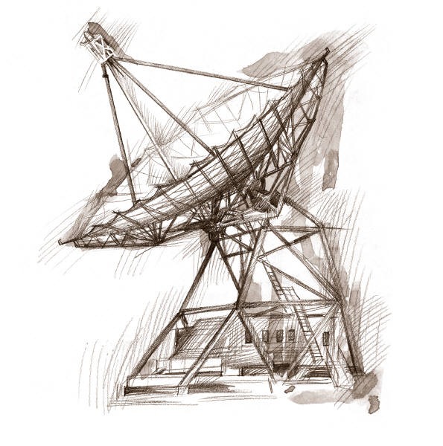
Transmission Mediums
Two mediums currently driving
the evolution of data communications transmission are:
Fiber optic transmissions
and
Wireless transmissions
Notes:
One of the basic choices facing a business user is the transmission medium.
For use within the business premises, this choice is generally completely up to the
business. For long-distance communications, the choice is generally but not always
made by the long-distance carrier. In either case, changes in technology are rapidly
changing the mix of media used. Of particular note are fiber optic transmission and
wireless transmission (e.g., satellite and cellular communications). These two media
are now driving the evolution of data communications transmission.
Fiber optic transmissions
The ever-increasing availability of fiber optic communication circuits is
making channel capacity a virtually free resource. Since the early 1980s, the growth
of the market for optical fiber transmission systems is without precedent. During
the past 10 years, the cost of fiber optic transmission has dropped by more than an
order of magnitude, and the capacity of such systems has grown at almost as rapid
a rate. Almost all of the long-distance telephone communications trunks within the
United States and the highest speed links on the Internet consist of fiber optic cable.
Because of its high capacity and its security characteristics (fiber is difficult to tap),
it is becoming increasingly used within office buildings and local area networks to
carry the growing load of business information. The spreading use of fiber optic
cable is also spurring advancements in communication switching technologies and
network management architectures.
Wireless transmissions
The increasing use of the second medium, wireless transmission, is a result
of the trend toward universal personal telecommunications and universal access
to communications. The first concept refers to the ability of a person to a single
account to use any communication system anytime-anywhere, ideally globally. The
second refers to the ability to use one’s preferred computing device in a wide variety
of environments to connect to information services (e.g., to have a laptop, smart phone,
or tablet that will work equally well in the office, on the street, and on an
airplane, bus, or train). Today, both concepts are subsumed under the business push
to support mobility. Wireless LANs have become common components of enterprise
networks as well as small office/home office networks, and smartphones and
tablets with wireless capabilities are rapidly becoming mainstream business user
communications devices. Mobility has the potential to unleash higher performance
at all business levels: personal, workgroup, and enterprise-wide. This provides compelling
rationale for further business investment in wireless technologies.

Slide 21
Transmission Services
Remain the most costly component of a communications budget
Two major approaches to greater efficiency:
Multiplexing
The ability of a number of devices to share a transmission facility
Compression
Squeezing the data down so that a lower-capacity, cheaper transmission facility can be used
Notes:
Despite the growth in the capacity and the drop in cost of transmission facilities,
transmission services remain the most costly component of a communications
budget for most businesses. Thus, the manager needs to be aware of techniques
that increase the efficiency of the use of these facilities. The two major approaches
to greater efficiency are multiplexing and compression. Multiplexing refers to the
ability of a number of devices to share a transmission facility. If each device needs
the facility only a fraction of the time, then a sharing arrangement allows the cost
of the facility to be spread over many users. Compression , as the name indicates,
involves squeezing the data down so that a lower-capacity, cheaper transmission
facility can be used to meet a given demand. These two techniques show up separately
and in combination in a number of types of communications equipment. The
manager needs to understand these technologies to assess the appropriateness and
cost-effectiveness of the various products on the market.

Slide 22
1-2 NETWORKS
A network is a set of devices (often referred to as nodes) connected by communication links. A node can be a computer, printer, or any other device capable of sending and/or receiving data generated by other nodes on the network. A link can be a cable, air, optical fiber, or any medium which can transport a signal carrying information.
Topics discussed in this section:
Network Criteria
Physical Structures
Categories of Networks

Slide 23
Network Criteria
Performance
Depends on Network Elements
Measured in terms of Delay and Throughput
Reliability
Failure rate of network components
Measured in terms of availability/robustness
Security
Data protection against corruption/loss of data due to:
Errors
Malicious users

Slide 24
Networks
It is estimated that by 2016 there will be over 20 billion fixed and mobile networked devices
This affects traffic volume in a number of ways:
It enables a user to be continuously consuming network capacity
Capacity can be consumed on multiple devices simultaneously
Different broadband devices enable different applications which may have greater traffic generation capability
Notes:
Globally, the number of Internet users is forecast to increase from approximately
2 billion in 2011 to 3 billion users in 2016. This figure is in fact misleading, as a
single end user may have multiple types of devices. The estimate for 2016 is that
there will be over 20 billion fixed and mobile networked devices and machine-to-
machine connections, up from about 7 billion devices in 2011. The increase in
the number of user devices, especially broadband devices, affects traffic volume
in a number of ways. It enables a user to be continuously consuming network
capacity, as well as to be consuming capacity on multiple devices simultaneously.
Also, different broadband devices enable different applications, which may have
greater traffic generation capability. The result is that the total annual traffic generated
over the Internet and other IP-based networks is forecast to rise from 372
exabytes (372 x 2⁶⁰ bytes) to 1.3 zettabytes (1.3 x 2⁷⁰ bytes) in 2016 [CISC12].
This traffic demand imposes stiff performance requirements on communications
protocols, which is previewed in Chapter 2, and on communications and computer
networks.
One type of network that has become commonplace is the local area network.
Indeed, LANs are to be found in virtually all medium- and large-size office buildings.
LANs, especially Wi-Fi LANs, are also increasingly used for small office and home
networks. As the number and power of computing devices have grown, so have the
number and capacity of LANs found in business networks. The development of
internationally recognized standards for LANs has contributed to their proliferation
in enterprises. Although Ethernet has emerged as the dominant LAN architecture,
business managers still have choices to make about transmission rates (ranging
from 100 Mbps to 100 Gbps) and the degree to which both wired and wireless LANs
will be combined within an enterprise network. Interconnecting and managing a
diverse collection of local area networks and computing devices within today’s business
networks presents ongoing challenges for networking professionals.

Slide 25
Networking
Advances in technology have led to greatly increased capacity and the concept of integration, allowing equipment and networks to work simultaneously
Voice
Data
Image
Video
Notes:
A business need for a robust network to support voice, data, image, and video
traffic is not confined to a single office building or LAN; today, it is an enterprise-wide
communication requirement. Advances in LAN switches and other data
communication technologies have led to greatly increased local area network
transmission capacities and the concept of integration. Integration means that
the communication equipment and networks can deal simultaneously with voice,
data, image, and even video. Thus, a memo or report can be accompanied by voice
commentary, presentation graphics, and perhaps even a short video introduction,
demonstration, or summary. Image and video services that perform adequately
within LANs often impose large demands on wide area network transmission and
can be costly. Moreover, as LANs become ubiquitous and as their transmission
rates increase, the need for enterprise networks to support interconnections among
geographically dispersed areas has increased. This, in turn, has forced businesses
increase wide area network transmission and switching capacity. Fortunately, the
enormous and ever-increasing capacity of fiber optic and wireless transmission services
provides ample resources to meet these business data communication needs.
However, the development of switching systems that are capable of responding to
the increasing capacities of transmission links and business communication traffic
requirements is an ongoing challenge not yet conquered.

Slide 26
Network Hardware(not broadly disscussin class)
Taxonomy of Networks
Personal Networks
Local Area Networks
Wide Area Networks
Wireless Networks

Slide 27
Classifying networks (not broadly disscussin class)
By transmission technology
By scale

Slide 28
Transmission technology
Types of transmission technology
Broadcast links
Point-to-point links

Slide 29
Point-to-point and Broadcast Networks
point-to-point
multiple access

Slide 30
Point-to-point links
Point-to-point links connect individual pairs of machines.
Packets : short messages
To go from the source to the destination, a packet on a network made up of point-to-point links may have to first visit one or more intermediate machines.
Often multiple routes, of different lengths, are possible
Unicasting:
exactly one sender and one receiver

Slide 31
Broadcast Networks
Broadcast networks have a single communication channel that is shared by all the machines on the network.
Packets sent by any machine are received by all the others.
An address field within the packet specifies the intended recipient. Upon receiving a packet, a machine checks the address field. If the packet is intended for the receiving machine, that machine processes the packet; if the packet is intended for some other machine, it is just ignored.

Slide 32
Broad/Multi-casting
Broadcasting
address a packet to all destinations by using a special code in the address field .
Multicasting
Some broadcast systems also support transmission to a subset of the machines

Slide 33
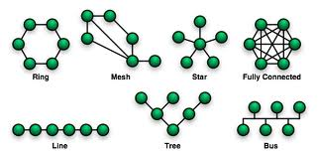

Network Topologies
Topology is the network's virtual shape or structure.
Node

Slide 34
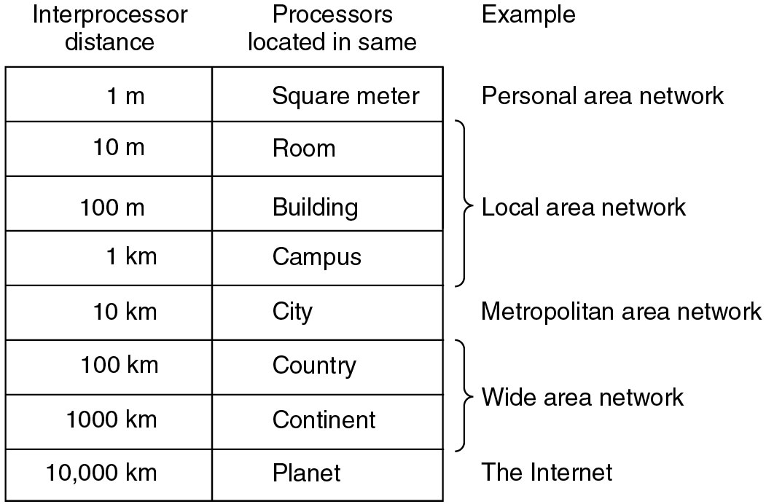
Classification by scale

Slide 35
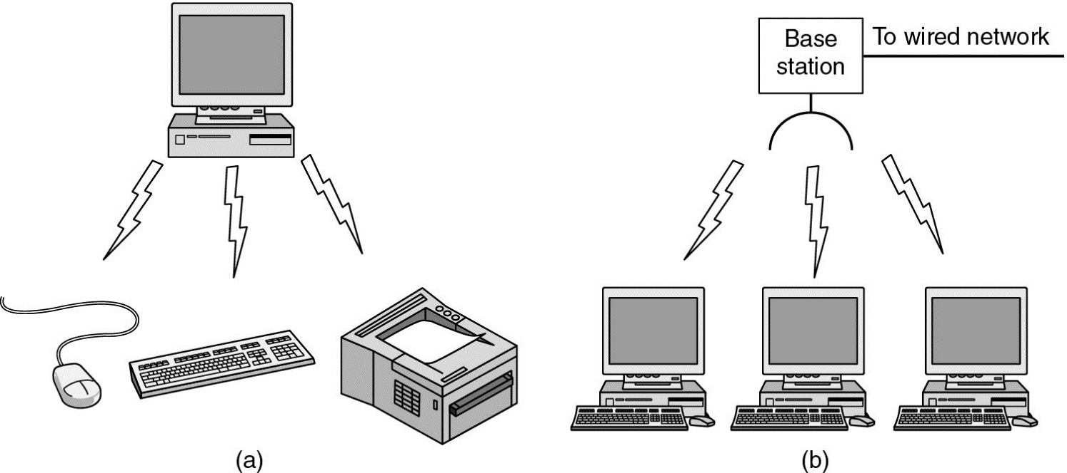
PAN (Personal area networks)
Bluetooth ( IEEE 802.15 )

Slide 36
Local Area Networks
A LAN is a privately owned network that operates with in and nearby a single building like a home, office or factory.
LANs are widely used to connect personal computers and consumer electronics to let them share resources and exchange information.

Slide 37
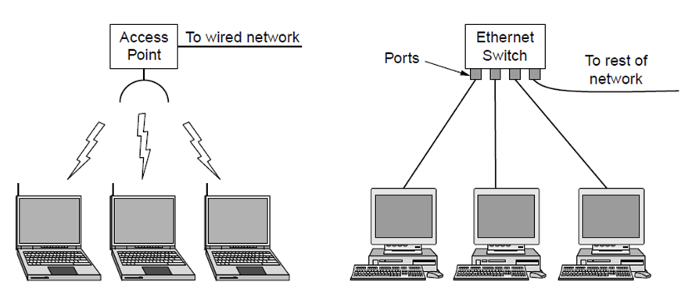
Wireless and wired LANs
Wireless and wired LANs.
(a) 802.11. (b) Switched Ethernet.

Slide 38
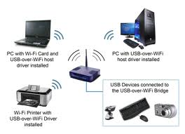
WLAN (Wireless LAN)
Wireless LAN (Wi-Fi IEEE 802.11 )

Slide 39
Wired LAN
Wired LANs characteristics
Use copper wires, optical fibers
Are restricted in size
Run at speeds of 10Mbps to 1Gbps
Low delay
Make very few errors

Slide 40
Ethernet: IEEE802.3
Ethernet is the most common type of wired LAN
Switched Ethernet
Each computer speaks the Ethernet protocol and connects to a box called a switch with a point-to-point link.
A switch has multiple ports, each of which can connect to one computer. The job of the switch is to relay packets between computers that are attached to it, using the address in each packet to determine which computer to send it to.

Slide 41
Expand and divide a LAN
Expand a LAN to make it larger
Switches can be plugged into each other using their ports
Divide one larger physical LAN into smaller logical LANs.
VLAN(virtual LAN)
Each switch port is tagged with a “tag”, the switch then forwards packets so that computers attached to the same color ports are separated from the others.

Slide 42
Classic Ethernet
The original Ethernet design broadcasts all the packets over a single linear cable.
At most one machine could successfully transmit at a time, and distributed arbitration mechanism was used to resolve conflicts.
Computers could transmit whenever the cable was idle
If two or more packets collided, each computer just waited a random time and tried later.

Slide 43
Channel Allocation methods for Broadcast networks
Static allocation
Divide time into discrete intervals and use a round-robin algorithm, allowing each machine to broadcast only when its time slot comes up.
It wastes channel capacity when a machine has nothing to say during its allocated slot, so most systems attempt to allocate the channel dynamically.
Dynamic allocation
Centralized: there is a single entity which determines who goes next.
Decentralized : there is no central entity, each machine must decide for itself whether to transmit.

Slide 44
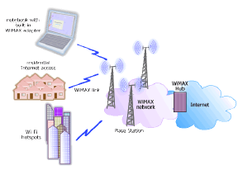
Wireless MAN
MAN covers a city
WiMax IEEE 802.16

Slide 45
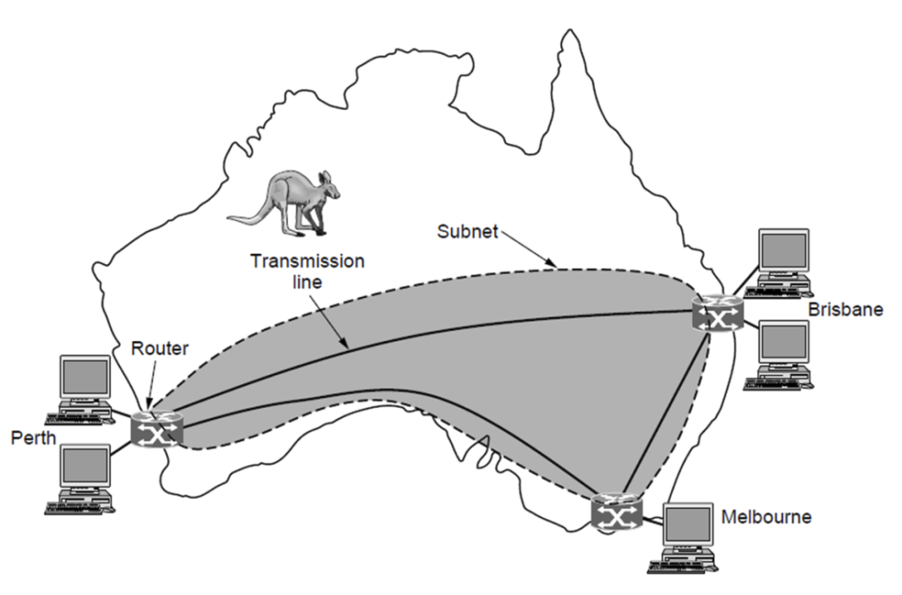
Wide Area Networks
A WAN spans a large geographical area, often a country or continent.
WAN that connects three branch offices in Australia

Slide 46
Communication Subnet(Components need to make WAN)
Transmission lines
copper wire, optical fiber, or even radio links.
Most companies do not have transmission lines lying about, so instead they lease the lines.
Switching elements
Switches are the specialized computers called routers that connect two or more transmission lines
Subnet:
A collection of routers and communication lines that moved packets from the source host to the destination.

Slide 47
Differences between WAN &LAN
In WAN, the hosts and subnet are owned and operated by different people
The routers will usually connect different kinds of networking technology.
What is connected to the subnet:
Individual computers
Could be entire LANs
This is how larger networks are built from smaller ones

Slide 48
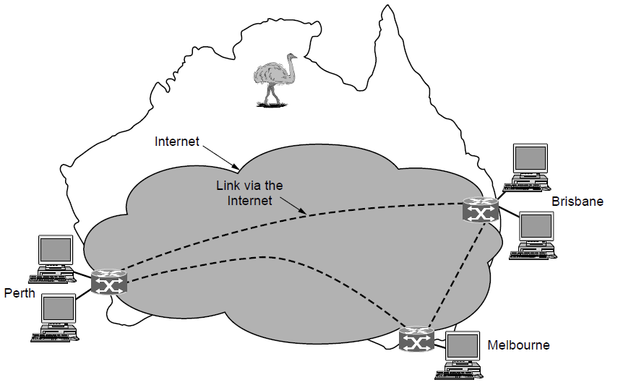
WAN via the Internet
VPN: flexible but lack control
WAN using a virtual private network.

Slide 49
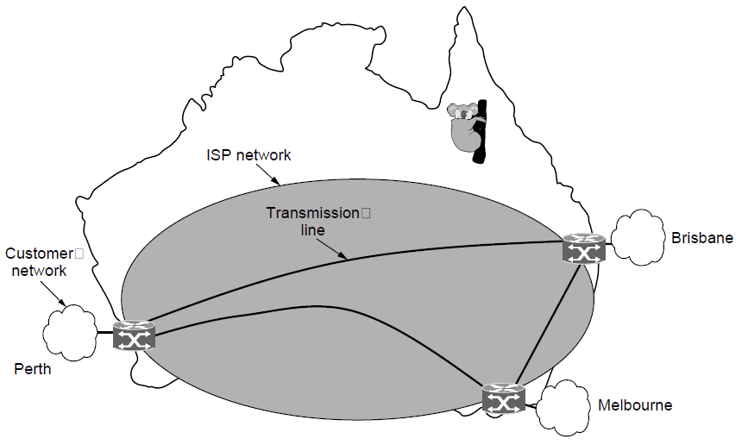
WAN via ISP network
The subnet is run by Internet Service Provider
WAN using an ISP network.

Slide 50
WAN Terms
Packet / Cell
the message is cut into packets before sending
Packet-switched / store-and-forward
the packet is received at each intermediate router in its entirety, stored there until the required output line is free, and then forwarded.
Routing algorithm
There may be many paths in the network that connect two computers. How the network makes the decision as to which path to use is called the routing algorithm.

Slide 51
Wide Area Networks (WANs)
Span a large geographical area
Require the crossing of public right-of-ways
Rely in part on common carrier circuits
Typically consist of a number of interconnected switching nodes
Notes:
Wide area networks generally cover a large geographical area. They often require
the crossing of public right-of-ways, and typically rely at least in part on circuits
provided by one or more common carriers —companies that offer communication
services to the general public. Typically, a WAN consists of a number of interconnected
switching nodes. A trans-mission from any one device is routed through
these internal nodes to the specified destination device. These nodes (including the
boundary nodes) are not concerned with the content of the data; rather, their purpose
is to provide a switching facility that will move the data from node to node
until they reach their destination.

Slide 52
Wide Area Networks
Alternative technologies used include:
Circuit switching
Packet switching
Frame relay
Asynchronous Transfer Mode (ATM)
Notes:
Traditionally, WANs have been implemented using one of two technologies:
circuit switching and packet switching. Subsequently, frame relay and ATM networks
assumed major roles. While ATM and, to some extent frame relay, are still
widely used, their use is gradually being supplanted by services based on gigabit
Ethernet and Internet Protocol technologies.

Slide 53
Circuit Switching
Uses a dedicated communications path
Connected sequence of physical links between nodes
Logical channel dedicated on each link
Rapid transmission
The most common example of circuit switching is the telephone network
Notes:
In a circuit-switching network, a dedicated communications
path is established between two stations through the nodes of the network. That
path is a connected sequence of physical links between nodes. On each link, a logical
channel is dedicated to the connection. Data generated by the source station are
transmitted along the dedicated path as rapidly as possible. At each node, incoming
data are routed or switched to the appropriate outgoing channel without delay. The
most common example of circuit switching is the telephone network.

Slide 54
Frame Relay(not covered)
Developed to take advantage of high data rates and low error rates
Operates at data rates of up to 2 Mbps
Key to achieving high data rates is to strip out most of the overhead involved with error control
Notes:
Packet switching was developed at a time when digital long-distance
transmission facilities exhibited a relatively high error rate compared to today’s
facilities. As a result, there is a considerable amount of overhead built into packet-switching
schemes to compensate for errors. The overhead includes additional bits
added to each packet to introduce redundancy and additional processing at the end
stations and the intermediate switching nodes to detect and recover from errors.
With modern high-speed telecommunications systems, this overhead is unnecessary
and counterproductive. It is unnecessary because the rate of errors has been
dramatically lowered and any remaining errors can easily be caught in the end
systems by logic that operates above the level of the packet-switching logic. It is
counterproductive because the overhead involved soaks up a significant fraction of
the high capacity provided by the network.
Frame relay was developed to take advantage of these high data rates and low
error rates. Whereas the original packet-switching networks were designed with a
data rate to the end user of about 64 kbps, frame relay networks are designed to
operate efficiently at user data rates of up to 2 Mbps. The key to achieving these
high data rates is to strip out most of the overhead involved with error control.

Slide 55
Asynchronous Transfer Mode (ATM) (not covered)
Referred to as cell relay
Culmination of developments in circuit switching and packet switching
Uses fixed-length packets called cells
Works in range of 10s and 100s of Mbps and in the Gbps range
Allows multiple channels with the data rate on each channel dynamically set on demand
Notes:
Asynchronous transfer mode, sometimes referred to as cell relay, is a culmination
of developments in circuit switching and packet switching. ATM can be
viewed as an evolution from frame relay. The most obvious difference between
frame relay and ATM is that frame relay uses variable-length packets, called
frames, and ATM uses fixed-length packets, called cells. As with frame relay, ATM
provides little overhead for error control, depending on the inherent reliability of
the transmission system and on higher layers of logic in the end systems to catch and
correct errors. By using a fixed packet length, the processing overhead is reduced
even further for ATM compared to frame relay. The result is that ATM is designed
to work in the range of 10s and 100s of Mbps, and in the Gbps range.
ATM can also be viewed as an evolution from circuit switching. With circuit
switching, only fixed-data-rate circuits are available to the end system. ATM allows
the definition of multiple virtual channels with data rates that are dynamically
defined at the time the virtual channel is created. By using small, fixed-size cells,
ATM is so efficient that it can offer a constant-data-rate channel even though it is
using a packet-switching technique. Thus, ATM extends circuit switching to allow
multiple channels with the data rate on each channel dynamically set on demand.

Slide 56
Local Area Networks (LAN)
LAN
Smaller scope, typically a single building
LANs are usually owned by the same organization that owns attached devices
Internal data rates greater than WANs
Most common configurations are switched LANs and wireless LANs
Notes:
As with WANs, a LAN is a communications network that interconnects a variety of
devices and provides a means for information exchange among those devices. There
are several key distinctions between LANs and WANs:
1. The scope of the LAN is small, typically a single building or a cluster of buildings.
This difference in geographic scope leads to different technical solutions,
as we shall see.
2. It is usually the case that the LAN is owned by the same organization that
owns the attached devices. For WANs, this is less often the case, or at least a
significant fraction of the network assets is not owned. This has two implications.
First, care must be taken in the choice of LAN, because there may be
a substantial capital investment (compared to dial-up or leased charges for
WANs) for both purchase and maintenance. Second, the network management
responsibility for a LAN falls solely on the user.
3. The internal data rates of LANs are typically much greater than those of
WANs.
LANs come in a number of different configurations. The most common are
switched LANs and wireless LANs. The most common switched LAN is a switched
Ethernet LAN, which may consist of a single switch with a number of attached
devices, or a number of interconnected switches. The most common type of wireless
LANs are Wi-Fi LANs.
As was just mentioned, wireless LANs are widely used in business environments.
Wireless technology is also common for both wide area voice and data networks.
Wireless networks provide advantages in the areas of mobility and ease of installation
and configuration.

Slide 57

The Internet
Internet evolved from ARPANET
Developed to solve the dilemma of communicating across arbitrary, multiple, packet-switched networks
Foundation is the TCP/IP protocol suite
Notes:
The Internet evolved from the ARPANET, which was developed in 1969 by the
Advanced Research Projects Agency (ARPA) of the U.S. Department of Defense.
It was the first operational packet-switching network. ARPANET began operations
in four locations. Today the number of hosts is in the hundreds of millions, the number
of users in the billions, and the number of countries participating nearing 200.
The number of connections to the Internet continues to grow exponentially.
The network was so successful that ARPA applied the same packet-switching
technology to tactical radio communication (packet radio) and to satellite communication
(SATNET). Because the three networks operated in very different
communication environments, the appropriate values for certain parameters, such
as maximum packet size, were different in each case. Faced with the dilemma of
integrating these networks, Vint Cerf and Bob Kahn of ARPA developed methods
and protocols for internetworking —that is, communicating across arbitrary, multiple,
packet-switched networks. They published a very influential paper in May
1974 [CERF74] outlining their approach to a Transmission Control Protocol. The
proposal was refined and details filled in by the ARPANET community, with major
contributions from participants from European networks eventually leading to the
TCP (Transmission Control Protocol) and IP (Internet Protocol) protocols, which,
in turn, formed the basis for what eventually became the TCP/IP protocol suite.
This provided the foundation for the Internet.

Slide 58
Computer Network: Internet overview

Slide 59
1-3 THE INTERNET(NOT)
The Internet has revolutionized many aspects of our daily lives. It has affected the way we do business as well as the way we spend our leisure time. The Internet is a communication system that has brought a wealth of information to our fingertips and organized it for our use.
Topics discussed in this section:
Organization of the Internet
Internet Service Providers (ISPs)

Slide 60
Roadmap
1.1 What is the Internet?
1.2 Network edge
end systems, access networks, links
1.3 Network core
circuit switching, packet switching, network structure
1.4 Delay, loss and throughput in packet-switched networks
1.5 Protocol layers, service models
1.6 Networks under attack: security
1.7 History

Slide 61

What’s the Internet: “nuts and bolts” view
PC
millions of connected computing devices: hosts = end systems
running network apps
Mobile network
server
Global ISP
wireless
laptop
cellular
handheld
Home network
communication links
fiber, copper, radio, satellite
transmission rate = bandwidth
Regional ISP
access
points
Institutional network
wired
links
routers: forward packets (chunks of data)
router

Slide 62
Internet:Switches and route
The two most prominent types of packet switches in today's Internet are routers and link-layer switches.
Link- layer switches are typically used in access networks, while routers are typically used in the network core.
The sequence of communication links and packet switches traversed by a packet from the sending end system to the receiving end system is known as a route or path through the network.

Slide 63
A Network of Networks
The end systems (PCs, smart phones, Web servers, mail servers, and so on) connect into the Internet via an access ISP.
The access ISPs themselves must be interconnected
A PoP is simply a group of one or more routers (at the same location) in the provider’s network where customer ISPs can connect into the provider ISP.
Any ISP (except for tier-1 ISPs) may choose to multi-home, that is, to connect to two or more provider ISPs.

Slide 64
A Network of Networks
Network Structure 1
interconnects all of the access ISPs with a single global transit ISP.
global transit ISP is a network of routers and communication links that not only spans the globe, but also has at least one router near each of the hundreds of thousands of access ISPs.
To be profitable, it would naturally charge each of the access ISPs for connectivity
the access ISP is said to be a customer and the global transit ISP is said to be a provider.

Slide 65
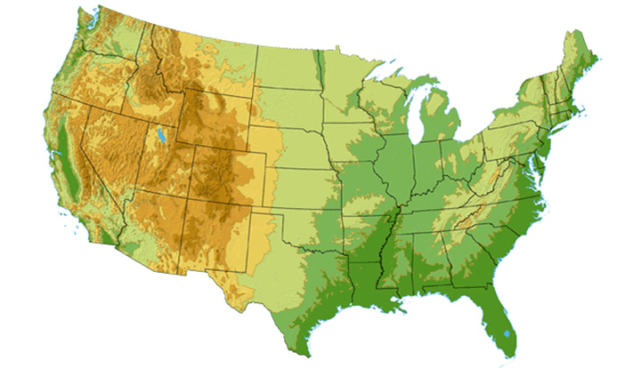

Tier-1 ISP: e.g., Sprint
Sprint US backbone network
DS3 (45 Mbps)
OC3 (155 Mbps)
OC12 (622 Mbps)
OC48 (2.4 Gbps)
Seattle
Tacoma
POP: point-of-presence
to/from backbone
Stockton
New York
Cheyenne
Chicago
Pennsauken
…
peering
Relay
….
San Jose
Roachdale
Wash. DC
Kansas City
Anaheim
…
…
…
Atlanta
to/from customers
Fort Worth
Orlando

Slide 66
A Network of Networks
Network Structure 2
Other companies to build their own global transit ISPs and compete with the original global transit ISP.
consists of the hundreds of thousands of access ISPs and multiple global transit ISPs.
global transit ISPs must be connected
It is a two-tier hierarchy with global transit providers residing at the top tier and access ISPs at the bottom
Only regional level presence of ISP’s (Regional ISPs connected to Tier-1 ISPs)

Slide 67
Internet structure: network of networks
roughly hierarchical
at center: “tier-1” ISPs (e.g., MCI, Sprint, AT&T, Cable and Wireless), national/international coverage
treat each other as equals
Tier-1 providers also interconnect at public network access points (NAPs)
Tier-1 providers interconnect (peer) privately
Tier 1 ISP
NAP
Tier 1 ISP
Tier 1 ISP

Slide 68
A Network of Networks
Network Structure 3
In some regions, there may be a larger regional ISP (possibly spanning an entire country) to which the smaller regional ISPs in that region connect; the larger regional ISP then connects to a tier-1 ISP.
there may be access ISPs in each city, which connect to provincial ISPs, which in turn connect to national ISPs, which finally connect to tier-1 ISPs
To approximate today’s Internet, we must add points of presence (PoPs), multi-homing, peering, and Internet exchange points (IXPs) to the hierarchical Network Structure 3.

Slide 69
Internet structure: network of networks
“Tier-2” ISPs: smaller (often regional) ISPs
Connect to one or more tier-1 ISPs, possibly other tier-2 ISPs
Tier-2 ISPs also peer privately with each other.
Tier-2 ISP pays tier-1 ISP for connectivity to rest of Internet
tier-2 ISP is customer of
tier-1 provider
Tier-2 ISP
Tier-2 ISP
Tier 1 ISP
Tier 1 ISP
Tier 1 ISP
Tier-2 ISP
Tier-2 ISP
Tier-2 ISP

Slide 70
A Network of Networks
Network Structure 4
A PoP is simply a group of one or more routers (at the same location) in the provider’s network where customer ISPs can connect into the provider ISP.
Any ISP (except for tier-1 ISPs) may choose to multi-home, that is, to connect to two or more provider ISPs.
an access ISP may multi-home with two regional ISPs, or it may multi-home with two regional ISPs and also with a tier-1 ISP.

Slide 71
Internet structure: network of networks
“Tier-3” ISPs and local ISPs
last hop (“access”) network (closest to end systems)
local
ISP
Tier 3
ISP
local
ISP
local
ISP
local
ISP
Local and tier- 3 ISPs are customers of
higher tier ISPs
connecting them to rest of Internet
Tier-2 ISP
Tier-2 ISP
Tier 1 ISP
NAP
Tier 1 ISP
Tier 1 ISP
Tier-2 ISP
Tier-2 ISP
Tier-2 ISP
local
ISP
local
ISP
local
ISP
local
ISP

Slide 72
A Network of Networks
Network Structure 5
built on top of Network Structure 4 by adding content provider networks.
Example: Google is currently one of the leading examples of such a content provider network.
Google has 30 to 50 data centers distributed across the globe via Googles private TCP/IP network
data centers house over one hundred thousand servers to few hundred severs
peered between them bypassing upper tiers and reducing cost and achieving greater control

Slide 73
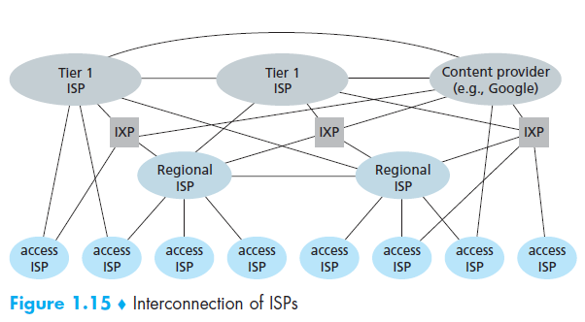
Nothing to read
Regional ISP=Tier2
Access ISP=Tier 3

Slide 74
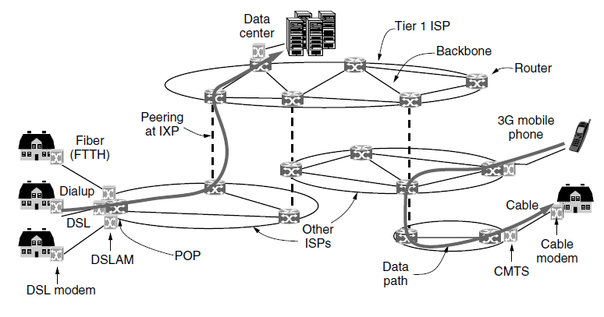
Nothing to read
IXPs (Internet eXchange
Points)

Slide 75
Internet structure: network of networks Nothing to read
a packet passes through many networks!
local
ISP
Tier 3
ISP
local
ISP
local
ISP
local
ISP
Tier-2 ISP
Tier-2 ISP
Tier 1 ISP
Tier 1 ISP
Tier 1 ISP
Tier-2 ISP
Tier-2 ISP
Tier-2 ISP
local
ISP
local
ISP
local
ISP
local
ISP

Slide 76
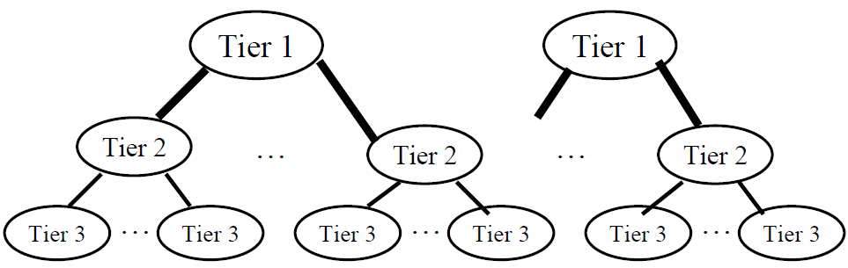
Internet:ISPs
End systems access the Internet through Internet Service Providers (ISPs). Each ISP is in itself a network of packet switches and communication links.
❑ Tier 1: Global or National, e.g., AT&T, Verizon, …
❑ Tier 2: Regional
❑ Tier 3: Local

Slide 77
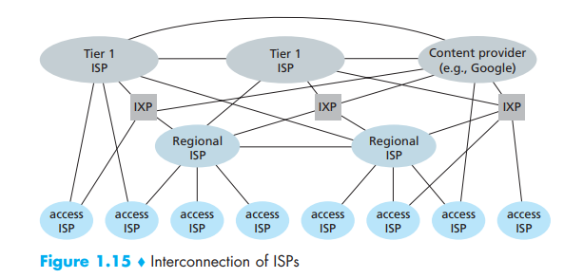
Adding content provider networks Nothing to read

Slide 78
What’s the Internet: “nuts and bolts” view(Skipped)
Protocols control sending, receiving of msgs
e.g., TCP, IP, HTTP, Skype, Ethernet
Internet: “network of networks”
loosely hierarchical
public Internet versus private intranet
Internet standards
RFC: Request for comments
IETF: Internet Engineering Task Force
Mobile network
Global ISP
Home network
Regional ISP
Institutional network

Slide 79
Internet: a services description Skipped
communication infrastructure enables distributed applications:
Web, VoIP, email, games, e-commerce, file sharing
communication services provided to apps:
reliable data delivery from source to destination
“best effort” (unreliable) data delivery

Slide 80
Internet: A Services Description Skipped
An infrastructure that provides services to applications
These applications include electronic mail , Web surfing, instant messaging, Voice-over-IP (VoiP), Internet radio, video streaming, distributed games, peer-to-peer (P2P) file sharing, television over the Internet, remote login, and much, much more.

Slide 81
Service:Utilizing API Skipped
End systems attached to the Internet provide an Application Programming Interface (API) that specifies how a software piece running on one end system asks the Internet infrastructure to deliver data to a specific destination software piece running on another end system.

Slide 82
Roadmap
1.1 What is the Internet?
1.2 Network edge
end systems, access networks, links
1.3 Network core
circuit switching, packet switching, network structure
1.4 Delay, loss and throughput in packet-switched networks
1.5 Protocol layers, service models
1.6 Networks under attack: security
1.7 History

Slide 83
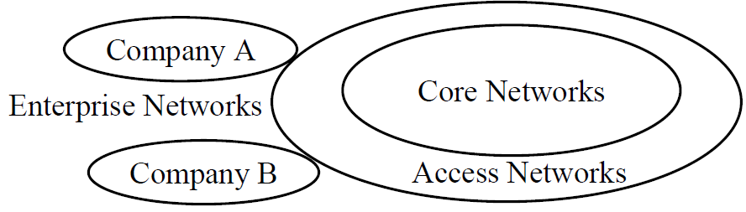
A closer look at network structure
The Network Edge Skipped
❑ Enterprise/Home Networks: Stub Networks.
Privately owned  Not owned by ISP
e.g., campus network: Ethernet and WiFi
❑ Access Network: Enterprise/Users to ISP (in the city)
WiFi, 3G/4G, DSL
❑ Core Network: ISP's network (between city): Optical Fiber

Slide 84
A closer look at network structure
The Network Edge
Network edge: applications and hosts
access networks, physical media: wired, wireless communication links
network core:
interconnected routers
network of networks

Slide 85
The network edge:
end systems (hosts):
run application programs
e.g. Web, email
at “edge of network”
peer-peer
client/server model
client host requests, receives service from always-on server
e.g. Web browser/server; email client/server
client/server
peer-peer model:
minimal (or no) use of dedicated servers
e.g. Skype, BitTorrent
Notes:
Differences:
Client-Server Network Peer-to-Peer Network
In Client-Server Network, Centralized dataserver While in Peer-to-Peer Network, Each peer has its own dataserver
is used to store the data.
.
In Client-Server Network, Server respond While in Peer-to-Peer Network, Each and every node can do both request and respond for the services.
the services which is request by Client.
Peer-to-peer networks are typically less secure than a client-server network because security is handled by the individual computers, not on the network as a whole.

Slide 86
Access networks and physical media (not covered!!!)
Q: How to connect end systems to edge router?
residential access nets
institutional access networks (school, company)
mobile access networks
bandwidth (bits per second) of access network
shared or dedicated?

Slide 87
Access networks and physical media (not covered!!!)
Access networks- the physical links that connect an end system to the first router (also known as the "edge router") on a path from the end system to any other distant end system .
Telco: The local wired telephone infrastructure is provided by a local telephone provider, which we will simply refer to as the local telco.
Each residence (household and apartment) has a direct, twisted-pair cooper link to a nearby telco switch, which is housed in a building called the central' office (CO) in telephony jargon.

Slide 88
Home Access: DSL, Cable, FTTH, Dial-Up, and Satellite (not covered!!!)
In developed world, more than 65 percent of the households have Internet access
In Korea, Netherlands, Finland, and Sweden more than 80 percent of households having Internet access, almost all via a high-speed broadband connection
Today, the two most prevalent types of broadband residential access are
Digital subscriber line (DSL) and
Cable.

Slide 89
Dial-up Modem (not covered!!!)
central office
telephone
network
Internet
home
PC
home dial-up
modem
ISP modem
(e.g., AOL)
Uses existing telephony infrastructure
Home is connected to central office
up to 56Kbps direct access to router (often less)
Can’t surf and phone at same time: not “always on”

Slide 90
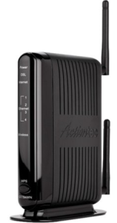
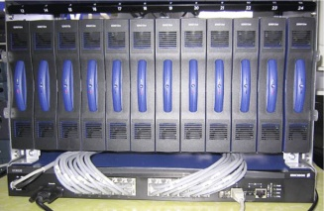
Digital Subscriber Line (DSL) (not covered!!!)
Existing phone line: 0-4KHz phone; 4-50KHz upstream data; 50KHz-1MHz downstream data
Internet
home
phone
DSLAM
telephone
network
splitter
DSL
modem
central
office
home
PC
The telephone line carries simultaneously both data and telephone signals, which are encoded at different frequencies:
Also uses existing telephone infrastruture
up to 1 Mbps upstream (today typically < 256 kbps)
up to 8 Mbps downstream (today typically < 1 Mbps)
dedicated physical line to telephone central office
DSLAM:A digital subscriber line access multiplexer
Asymmetric

Slide 91
VDSL (not covered!!!)
Higher speed DSL
Very- high speed DSL (VDSL), with highest penetration today in South Korea and Japan
12 to 55 Mbps for downstream and
1 .6 to 20 Mbps for upstream
Why called symmetric?
Because the downstream and upstream rates are different

Slide 92
Residential access: using cable modems (not covered!!!)
In a traditional cable television system, a cable head end broadcasts television channels through a distribution network of coaxial cable and amplifiers to residences.
Does not use telephone infrastructure
Instead uses cable TV infrastructure
HFC: Hybrid Fiber Coax
asymmetric: DOCSIS 2.0 standard defines: up to 42.8Mbps downstream, 30.7 Mbps upstream
network of cable and fiber attaches homes to ISP router
homes share access to router
unlike DSL, which has dedicated access, it is a shared broadcast medium
Cable Internet access requires special modems, called cable modems.

Slide 93
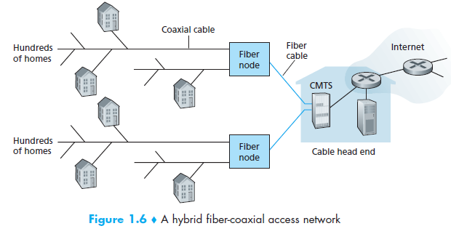
Cable Internet access (not covered!!!)
Cable modems divide the HFC network into two channels, a downstream and an upstream channel.
Cable Modem Termination System (CMTS)
Cable Head End

Slide 94
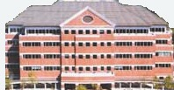
Cable Network Architecture: Inner structure (not covered!!!)
Typically 500 to 5,000 homes
cable headend
cable distribution
network (simplified)
home

Slide 95
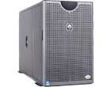
Cable Network Architecture: Overview (not covered!!!)
server(s)
cable headend
cable distribution
network
home

Slide 96
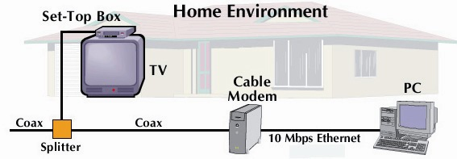
Cable Network Architecture: Overview (not covered!!!)
cable headend
cable distribution
network (simplified)
home

Slide 97
Cable Network Architecture: Overview (not covered!!!)
FDM
C
O
N
T
R
O
L
V
I
D
E
O
V
I
D
E
O
V
I
D
E
O
V
I
D
E
O
V
I
D
E
O
V
I
D
E
O
D
A
T
A
D
A
T
A
1
2
3
4
5
6
7
8
9
Channels
cable headend
cable distribution
network
home

Slide 98
Fiber to the Home(FTTH) (not covered!!!)
Direct Optical links from central office to the home (Direct fiber)
Two competing optical technologies: (shared)
Passive Optical network (PONs)
Active Optical Network (AONs) (switched)
Much higher Internet rates; fiber also carries television and phone services

Slide 99
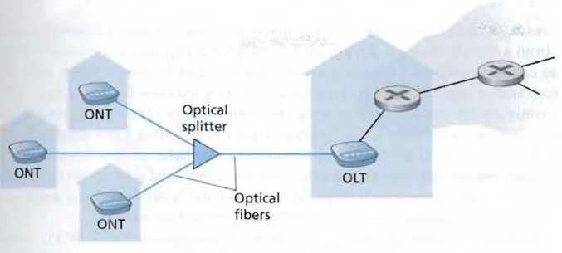
Verizon FIOS service (not covered!!!)
Telco’s CO
Optical Network Terminator (ONT)
Opto-electrical conversion
Optical Line Terminator ( O LT)
PON
Most FTTH customers today enjoy download rates in the 10 to 20 Mbps range and upload rates in the 2 to 10 Mbps range.

Slide 100
Access in the Enterprise (and the Home): Ethernet Internet access (not covered!!!)
100 Mbps
Institutional
router
Ethernet
switch
To Institution’s ISP
100 Mbps
1 Gbps
100 Mbps
server
Typically used in companies, universities, etc
10 Mbs, 100Mbps, 1Gbps, 10Gbps Ethernet
Today, end systems typically connect into Ethernet switch

Slide 101
Wireless access networks (not covered!!!)
shared wireless access network connects end system to router
via base station aka “access point”
wireless LANs:
802.11b/g (WiFi): 11 or 54 Mbps
wider-area wireless access
provided by telco operator
~1Mbps over cellular system (EVDO, HSDPA)
next up (?): WiMAX (10’s Mbps) over wide area
router
base
station
mobile
hosts

Slide 102
Home networks (not covered!!!)
Typical home network components:
DSL or cable modem
router/firewall/NAT
Ethernet
wireless access
point
wireless
laptops
to/from
cable
headend
cable
modem
router/
firewall
wireless
access
point
Ethernet

Slide 103
Wide-Area Wireless Access: 3G and LTE (not covered!!!)
(3G) wireless, provides packet-switched wide-area wireless Internet access at speeds in excess of 1 Mbps.
Higher-speed wide-area access technologies—a fourth-generation (4G) of wide-area wireless networks—are
already being deployed
LTE: Long-Term Evolution:can potentially achieve rates in excess of 10 Mbps.
LTE downstream rates of many tens of Mbps have been reported in commercial deployments.

Slide 104
(not covered!!!)
Notes:
Figure 1.5 illustrates the key elements that comprise the Internet. The purpose of
the Internet, of course, is to interconnect end systems, called hosts ; these include
PCs, workstations, servers, mainframes, and so on. Most hosts that use the Internet
are connected to a network , such as a local area network or a wide area network
(WAN). These networks are in turn connected by routers . Each router attaches to
two or more networks. Some hosts, such as mainframes or servers, connect directly
to a router rather than through a network.
In essence, the Internet operates as follows. A host may send data to another
host anywhere on the Internet. The source host breaks the data to be sent into a
sequence of packets, called IP datagrams or IP packets . Each packet includes a
unique numeric address of the destination host. This address is referred to as an IP
address , because the address is carried in an IP packet. Based on this destination
address, each packet travels through a series of routers and networks from source
to destination. Each router, as it receives a packet, makes a routing decision and
forwards the packet along its way to the destination.

Slide 105
(not covered!!!)
Notes:
The Internet today is made up of thousands of overlapping hierarchical networks.
Because of this, it is not practical to attempt a detailed description of the exact
architecture or topology of the Internet. However, an overview of the common, general
characteristics can be made. Figure 1.6 illustrates the discussion and Table 1.2
summarizes the terminology.
A key element of the Internet is the set of hosts attached to it. Simply put, a
host is a computer. Today, computers come in many forms, including mobile phones
and even cars. All of these forms can be hosts on the Internet. Hosts are sometimes
grouped together in a LAN. This is the typical configuration in a corporate environment.
Individual hosts and LANs are connected to an Internet service provider
(ISP) through a point of presence (POP) . The connection is made in a series of
steps starting with the customer premises equipment (CPE) . The CPE is the communications
equipment located onsite with the host.
For a number of home users, the CPE was traditionally a 56-kbps modem. This
was adequate for e-mail and related services but marginal for graphics-intensive
Web surfing. Today’s CPE offerings provide greater capacity and guaranteed service
in some cases. A sample of these access technologies includes DSL, cable modem,
terrestrial wireless, and satellite. Users who connect to the Internet through their
work often use workstations or PCs connected to their employer-owned LANs,
which in turn connect through shared organizational trunks to an ISP. In these cases
the shared circuit is often a T-1 connection (1.544 Mbps), while for very large organizations
T-3 connections (44.736 Mbps) are sometimes found. Alternatively, an
organization’s LAN may be hooked to a WAN, such as a frame relay network, which
in turn connects to an ISP.

Slide 106
Table 1.2 (not covered!!!) Internet Terminology
Central Office (CO)
The place where telephone companies terminate customer lines and locate switching equipment to interconnect those lines with other networks
Customer Premises Equipment (CPE)
Telecommunications equipment that is located on the customer’s premises
Internet Service Provider (ISP)
A company that provides other companies or individuals with access to, or presence on, the Internet
Network Access Point (NAP)
One of several major Internet interconnection points that serve to tie all the ISPs together
Network Service Provider (NSP)
A company that provides backbone services to an Internet service provider (ISP)
Point of Presence (POP)
A site that has a collection of telecommunications equipment, usually refers to ISP or telephone company sites
(Table can be found on page 51 in textbook)
Notes:
The CPE is physically attached to the “local loop” or “last mile.” This is
the infrastructure between a provider’s installation and the site where the host is
located. For example, a residential user with a DSL modem attaches the modem
to the telephone line. The telephone line is typically a pair of copper wires that
runs from the house to a central office (CO) owned and operated by the telephone
company, with perhaps the use of optical fiber for a large portion of that link. If
the home user has a cable modem, the local loop is the coaxial cable that runs from
the home to the cable company facilities. The preceding examples are a bit of an
oversimplification, but they suffice for this discussion. In many cases the wires that
leave a home are aggregated with wires from other homes and then converted to
a different media such as fiber. In these cases the term local loop still refers to the
path from the home to the CO or cable facility. The local loop provider is not necessarily
the ISP. In many cases the local loop provider is the telephone company
and the ISP is a large, national service organization. Often, however, the local loop
provider is also the ISP.
Other forms of CPE-ISP connection do not go through a telephone company
CO. For example, a cable link would connect the local user to the cable company
site, which would include or link to an ISP. Mobile users can take advantage of a
wireless link to a Wi-Fi access point that provides access to the Internet. And corporate
access to an ISP may be by dedicated high-speed links or through a wide area
network, such as an asynchronous transfer mode or frame relay network.
The ISP provides access to its larger network through a POP. A POP is simply
a facility where customers can connect to the ISP network. The facility is sometimes
owned by the ISP, but often the ISP leases space from the local loop carrier. A POP
can be as simple as a bank of modems and an access server installed in a rack at the
CO. The POPs are usually spread out over the geographic area where the provider
offers service. The ISP acts as a gateway to the Internet, providing many important
services. For most home users, the ISP provides the unique numeric IP address
needed to communicate with other Internet hosts. Most ISPs also provide name
resolution and other essential network services. The most important service an ISP
provides, though, is access to other ISP networks. Access is facilitated by formal
peering agreements between providers. Physical access can be implemented by connecting
POPs from different ISPs. This can be done directly with a local connection
if the POPs are collocated or with leased lines when the POPs are not collocated.
A more commonly used mechanism is the network access point (NAP) .
A NAP is a physical facility that provides the infrastructure to move data
between connected networks. In the United States, the National Science Foundation
(NSF) privatization plan called for the creation of four NAPs. The NAPs were built
and operated by the private sector. The number of NAPs has grown significantly
over the years, and the technology employed has shifted from Fiber Distributed
Data Interface (FDDI) and Ethernet to ATM and Gigabit Ethernet. Most NAPs
today have an ATM core. The networks connected at a NAP are owned and operated
by network service providers (NSPs) . A NSP can also be an ISP but this is
not always the case. Peering agreements are between NSPs and do not include the
NAP operator. The NSPs install routers at the NAP and connect them to the NAP
infrastructure. The NSP equipment is responsible for routing, and the NAP infrastructure
provides the physical access paths between routers.

Slide 107
(not covered!!!)
Notes:
To give some feel for the scope of concerns of this book, Figure 1.7 illustrates some
of the typical communications and network elements in use today. At the center
of the figure is an IP backbone network, which could represent a portion of the
Internet or an enterprise IP network. Typically, the backbone consists of high performance
routers, called core routers , interconnected with high-volume optical
links. The optical links make use of what is known as wavelength division multiplexing
(WDM), such that each link has multiple logical channels occupying different
portions of the optical bandwidth.
At the periphery of an IP backbone are routers that provide connectivity
to external networks and users. These routers are sometimes referred to as edge
routers, or aggregate routers. Aggregate routers are also used within an enterprise
network to connect a number of routers and switches to external resources, such
as an IP backbone or a high-speed WAN. As an indication of the capacity requirements
for core and aggregate routers, [XI11] reports on an analysis that projects
these requirements for Internet backbone providers and large enterprise networks
in China. The analysis concludes the aggregation router requirements to be in the
range of 200 Gbps to 400 Gbps per optical link by 2020, and 400 Gbps to 1 Tbps per
optical link for core routers by 2020.
The upper part of the figure depicts a portion of what might be a large enterprise
network. The figure shows two sections of the network connected via a private
high-speed asynchronous transfer mode (ATM) WAN, with switches interconnected
with optical links. Enterprise assets are connected to, and protected from,
an IP backbone or the Internet via routers with firewall capability, a not uncommon
arrangement for implementing the firewall.
The lower left of the figure depicts what might be a configuration for a small or
medium-size business, which relies on an Ethernet LAN configuration. Connection
to the Internet through a router could be through a cable digital subscriber line
connection or a dedicated high-speed link.
The lower portion of the figure also shows an individual residential user connected
to an Internet service provider through some sort of subscriber connection.
Common examples of such a connection are a digital subscriber line, which provides
a high-speed link over telephone lines and requires a special DSL modem;
and a cable TV facility, which requires a cable modem, or some type of wireless
connection. In each case, there are separate issues concerning signal encoding, error
control, and the internal structure of the subscriber network.
Finally, mobile devices, such as smartphones and tablets, can connect to the
Internet through the public cellular network, which has a high-speed connection,
typically optical, to the Internet.
The ISPs are not explicitly shown in the figure. Typically, an ISP network will
consist of a number of interconnected routers connected to the Internet through a
high-speed link. The Internet consists of a number of interconnected routers that
span the globe. The routers forward packets of data from source to destination
through the Internet.
A variety of design issues, such as signal encoding and error control, relate
to the links between adjacent elements, such as between routers on the Internet or
between switches in the ATM network, or between a subscriber and an ISP. The
internal structure of the various networks (telephone, ATM, Ethernet) raises additional
issues. We will be occupied throughout much of this book with the design
features suggested by Figure 1.7.

Slide 108
Protocols

Slide 109
1-4 PROTOCOLS
A protocol is synonymous with rule. It consists of a set of rules that govern data communications. It determines what is communicated, how it is communicated and when it is communicated. The key elements of a protocol are syntax, semantics and timing
Topics discussed in this section:
Syntax
Semantics
Timing

Slide 110
Elements of a Protocol
Syntax
Structure or format of the data
Indicates how to read the bits - field delineation
Semantics
Interprets the meaning of the bits
Knows which fields define what action
Timing
When data should be sent and what
Speed at which data should be sent or speed at which it is being received.

Slide 111
Network Software
Protocol Hierarchies
Design Issues for the Layers
Connection-Oriented and Connectionless Services
Service Primitives
The Relationship of Services to Protocols

Slide 112
Philosophy of Protocol Hierarchies
Layering:
To reduce their design complexity, most networks are organized as a stack of layers or levels, each one built upon the one below it.
Services:
The purpose of each layer is to offer certain service to the higher layer, shielding those layers from the details of how the offered services are actually implemented.

Slide 113
Layer n Protocol
Layer n on one machine carries on a conversation with layer n on another machine. The rules and conventions used in this conversation are collectively known as the layer n protocol.
A protocol is an agreement between communicating parties on how communication is to proceed.

Slide 114
What Is A Protocol
Human protocols:
“what’s the time?”
“How are you doing?”
“I have a question”
Specific messages sent
Specific actions taken when messages received, or other events
• Protocols define format, order of messages sent and
received among network entities, and actions taken
on message transmission and receipt.

Slide 115
Protocol Example
Network protocols:
Machines rather than humans
All communication activity in Internet governed by protocols

Slide 116
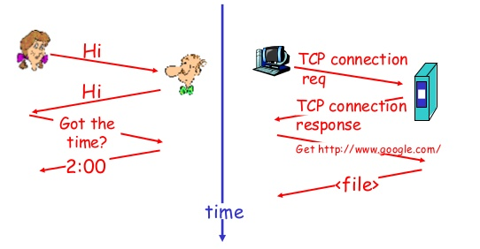
Protocol Example
Human
Network

Slide 117
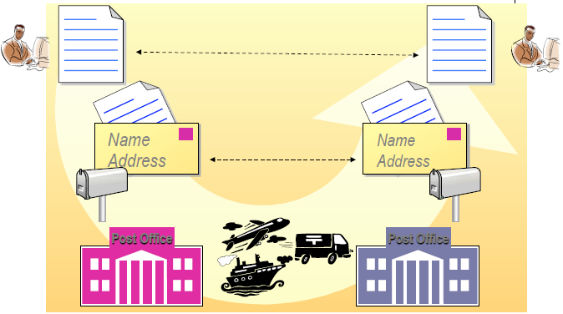
Hierarchy Example

Slide 118
Terminology(31 march ends)
Peers
The entities comprising the corresponding layers on different machines are called peers. The peers may be processes, hardware devices, or even human beings. In other words, it is the peers that communicate by using the protocol.
Interface:
Between each pair of adjacent layers is an interface. The interface defines which primitive operations and services the lower layer makes available to the upper one.

Slide 119
Protocol stack
Protocol stack:
A list of protocols used by a system, one protocol per layer, is called a protocol stack.
Network architecture
A set of layers and protocols is called a network architecture.

Slide 120
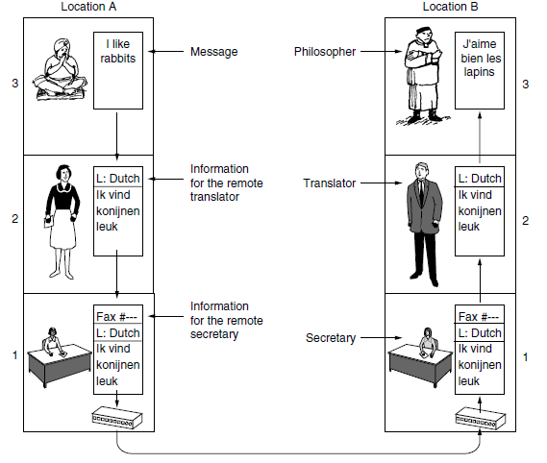
Analogy of Protocol Hierarchies
The philosopher-translator-secretary architecture

Slide 121
Terminology(Not Covered)
Header:
Upper layer puts a header in front of the message to identify the message and passes the result to lower layer
The header includes control information such as sequence numbers to keep the right order.
Size of messages
There is always a limit to the size of messages imposed by certain layer protocol. So incoming messages must be broken into smaller units (packets) in this layer.

Slide 122
Software or hardware? (Not Covered)
Although this section is called '‘network software”, it is worth pointing out that the lower layers of a protocol hierarchy are frequently implemented in hardware or firmware. Nevertheless, complex protocol algorithms are involved, even if they are embedded (in whole or in part) in hardware.

Slide 123
Design Issues for the Layers (Not Covered)
Reliability
Network Evolution
Resource Location
Against Threats

Slide 124
Reliability (Not Covered)
Reliability: Making a network that operates correctly even though it is made up of a collection of components that are themselves unreliable.
Mechanisms:
Error detection
Find errors in received information.
Error correction
Fix errors in received information.
Routing
Find a working path through a network.

Slide 125
Network Evolution (Not Covered)
Protocol Layering
Support change
Addressing or Naming
Every layer needs a mechanism for identifying senders and receivers.
Internetworking
Different network technologies often have different limitations.
Scalable
Design work well when the network gets large

Slide 126
Resource allocation (Not Covered)
Networks provide a service to hosts from their underlying resource, such as the capacity of transmission lines.
Statistical multiplexing
Share network bandwidth dynamically
Flow control
Keep a fast sender from swamping a slow receiver with data.
Congestion
Network overloading
Quality of Service
Differential service for real-time delivery and other.

Slide 127
Against Threat (Not Covered)
Confidentiality
Against eavesdropping
Authentication
Prevent impersonation
Integrity
Prevent surreptitious changes to messages

Slide 128
Connection-Oriented vs. Connectionless Services (Not Covered)
Layers can offer two different types of service to the layers above them:
Connection-oriented
Connectionless

Slide 129
Connection-oriented service (Not Covered)
Like the telephone system. The system establishes a connection, uses it, and closes it.
Acts like a tube (Circuit). Data comes out the other end in the same order as it goes in.
Connection Setup (negotiation)
Data Transfer
Connection Termination

Slide 130
Connectionless service (Not Covered)
Like the postal system. Each message carries the full destination address and each one is routed through the intermediate nodes inside the system independent of all the subsequent messages.
It is possible that the first one sent can be delayed so that the subsequent messages arrive first.
Message has a name: a packet in network layer
Store-and-forward switching vs. cut-through switching.

Slide 131
Quality of service (Not Covered)
Each service can be characterized by a QoS:
Reliability: Will the message arrive?
A reliable service is implemented by acknowledgement (a receipt from the receiver).
Delay (Latency)
Delays and overhead are introduced in the ack process

Slide 132
Reliable connection-oriented service (Not Covered)
A reliable connection-oriented service guarantees success. They never lose data.
Message sequence - message boundaries and order are maintained.
Byte streams - messages are broken up or combined; flow is bytes. Can pair mechanism with upper-layer requirements.
A typical situation in which a reliable connection-oriented service is appropriate is file transfer.

Slide 133
Unreliable Connectionless Service (Not Covered)
Connectionless Service /Datagram Service:
For some applications, the transit delay introduced by acks are unacceptable. Like Voice Over IP.
Not all applications require connections. Like junk mail. It's not worth the cost to determine if it actually arrived. Needs a high probability of arrival, but 100% not required. Connectionless, no acknowledgment.
Acknowledged datagram service:
As above, but improved reliability via acknowledgment.
Request-reply service:
Acknowledgment is in the form of a reply.

Slide 134
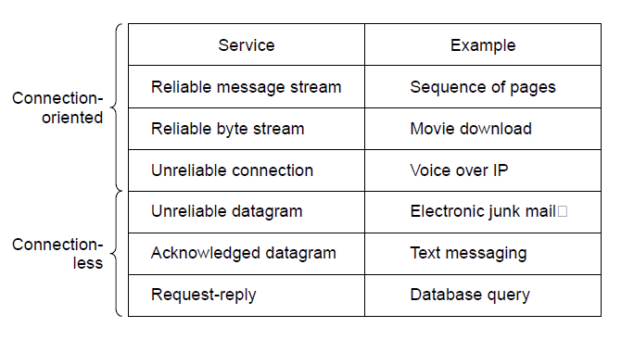
Connection-Oriented and Connectionless Services (Not Covered)
Six different types of service

Slide 135
Service Primitives (Not Covered)
A service is formally specified by a set of primitives (operations) available to a user process to access the service.
These primitives tell the service to perform some action or report on an action taken by a peer entity.
If the protocol stack is located in the operating system, as it often is, the primitives are normally system calls

Slide 136
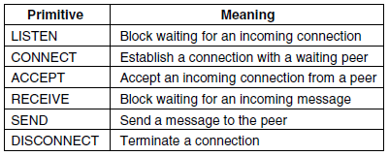
Service Primitives (Not Covered)
Six service primitives for implementing a simple connection-oriented service.
As a minimal example of the service primitives that
might provide a reliable byte stream

Slide 137
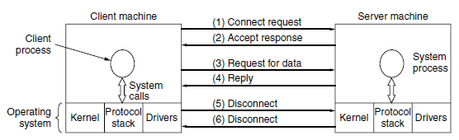
Service Primitives (Not Covered)
A simple client-server interaction using acknowledged datagrams.

Slide 138
Services to Protocols Relationship (Not Covered)
A service is a set of primitives (operations) that a layer provides to the layer above it. The service defines what operations the layer is prepared to perform on behalf of its users, but it says nothing at all about how these operations are implemented.
A protocol, in contrast, is a set of rules governing the format and meaning of the packets, or messages that are exchanged by the peer entities within a layer. Entities use protocols to implement their service definitions.

Slide 139
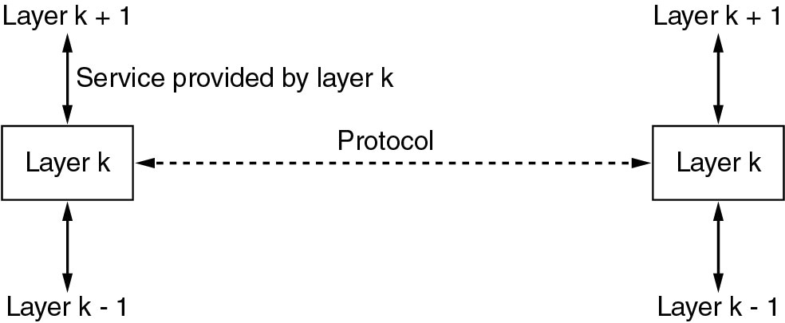
Layer K: a service and a protocol
In other words, services relate to the interfaces between layers. In contrast, protocols relate to the packets sent between peer entities on different machines.

Slide 140
Layer K: a service and a protocol(4 April)
In other words, services relate to the interfaces between layers. In contrast, protocols relate to the packets sent between peer entities on different machines.

Slide 141
Reference Model

Slide 142
Reference Models
The OSI Reference Model
The TCP/IP Reference Model
The Model used in this course
A Comparison of the OSI and TCP/IP
A Critique of the OSI Model and Protocols
A Critique of the TCP/IP Reference Model

Slide 143
OSI vs. TCP/IP reference model
The protocols associated with the OSI(Open System Interconnect) model are rarely used any more, the model itself is actually quite general and still valid, and the features discussed at each layer are still very important.
The TCP/IP model has the opposite properties: the model itself is not of much use but the protocols are widely used.

Slide 144
The OSI Reference Model
Principles used to develop OSI Layering (Developed by ISO: International Standards Organization (1983,revised in 1995)):
Need a layer for each different level of abstraction.
Each layer performs a well defined function.
Each layer should be standardizable.
Layer boundaries should minimize data flow across those boundaries.
The right number of layers - don't put too many functions together, but not too many layers either.

Slide 145
Physical Layer
Purpose
Transmits raw bits across a medium.
Concerns are
Voltage: how many volts for 1 / 0
Timing: how many ns a bit lasts
Duplexing: transmission in both directions?
Connectors: how many pins? What is each pin?
etc.

Slide 146
Data Link Layer
Purpose:
Transform a raw transmission line into a line that appears free of undetected transmission errors to the networks layer
Concerns:
Framing - Breaks apart input data into frames and transmit the frames sequentially.
Error handling – if the service is reliable, the receiver confirms correct receipt of each frame by sending back an acknowledgement frame.
Flow control - keeps a fast transmitter from drowning a slow receiver in data.
Medium Access Control – how to control access to the shared channel for broadcast networks.

Slide 147
Network Layer
Purpose
Route packets from source to destination
Concerns
Routing - What path is followed by packets from source to destination. Can be based on a static table, can be determined when the connection is created, or can be highly dynamic, being determined anew for each packet, to reflect the current network load.
Congestion - Controls the number packets in the subnet.
Qos – Quality of service provided(delay, transit time, jitter…)
Heterogeneity - Interfacing so one type of network can talk to another. Addressing, packet size, protocols…

Slide 148
Transport Layer
Purpose
Accept data from above it, split it up into smaller units if need be, pass them to network layer, and ensure that the pieces all arrive correctly at the other end.

Slide 149
Transport Layer
Concerns
Service Decisions - What type of service to provide; error-free point to point, datagram, etc.
End-to-end: it carries data all the way from the source process to the destination process .
Reliability - Ensures that packets arrive at their destination. Reassembles out of order messages.
Hides network - Allows details of the network to be hidden from higher level layers.
Multiplexing/demultiplexing - Determines which messages belong to which connections.
Flow control - keeps a fast transmitter from flooding a slow receiver.

Slide 150
Session Layer
Purpose
Allow users on different machines to establish sessions between them
Concerns
Dialog control - keep track of whose turn it is to transmit
Token Management – prevent two parties from attempting the same critical operation at the same time
Synchronization – checkpointing long transmissions to allow them to pick up from where they left off in the event of a crash and subsequent recovery.

Slide 151
Presentation Layer
Purpose
Make it possible for computers with different data representations to communicate
Concerns
Syntax and semantics of information transmitted.
Understands the nature of the data being transmitted. Converts ASCII/EBCDIC, big endian/little endian

Slide 152
Application Layer
contains a variety of protocols that are commonly needed by users.
HTTP
FTP
SMTP
…

Slide 153
U.S. DoD ARPANET(Not Covered)
Was a research network sponsored by the DoD .
Network be able to survive loss of subnet hardware, with existing conversations not being broken off .
A flexible architecture was needed since applications with divergent requirements were envisioned, ranging from transferring files to realtime speech transmission

Slide 154
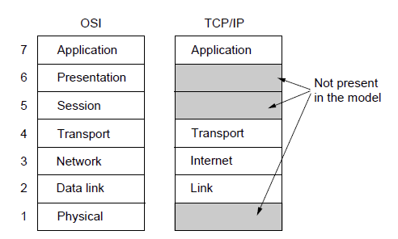
The TCP/IP Reference Models https://www.javatpoint.com/osi-vs-tcp-ip
The TCP/IP reference model (Cerf & Kahn1974, Clark 1988)
Notes:
TCP needs less layer than OSI
TCP model compels to use some fixed IP like http,ftp

Slide 155
The Key
a packet-switching network based on a connectionless layer that runs across different networks.

Slide 156
Link Layer
Describes what link such as serial lines and classic Ethernet must do to meet the needs of the connectionless internet layer.
It is not really a layer at all, in the normal sense of the term, but rather an interface between hosts and transmission links.

Slide 157
The Internet Layer
Permit hosts to inject packets into any network and have them travel independently to the destination ( potentially on a different network, like international mail)
Routing and Congestion control
IP (Internet Protocol)
ICMP(Internet Control Message Protocol)

Slide 158
Transport Layer
End2End (process2process): Allows peer entities to communicate.
TCP - Transmission Control Protocol provides a reliable connection oriented protocol that delivers a byte stream from one node to another.
Guarantees delivery and provides flow control.
UDP - User Datagram Protocol provides an unreliable connection-less protocol for applications that provide their own.

Slide 159
Application Layer
Terminal - Telnet
File transfer – FTP
The Web - HTTP
…

Slide 160
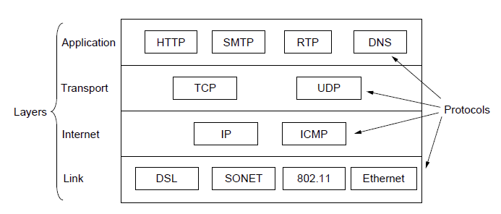
The TCP/IP Reference Models
The TCP/IP reference model with some protocols we will study

Slide 161
Comparing OSI and TCP/IP Models
Concepts central to the OSI model
Services
Interfaces
Protocols
OSI has good definition of service, interface, and protocol as discussed before. Fits well with object oriented programming concepts. Protocols are better hidden.

Slide 162
Comparing OSI and TCP/IP Models
The TCP/IP model did not originally distinguish between service, interface, and protocol.
With TCP/IP, the protocols came first; model was just a description of the protocols. But then the model isn't good for any other protocols.

Slide 163
Example Networks
The Internet
Mobile Phone Networks
Wireless LANs: 802.1

Slide 164
Different Philosophy
Which is first?
Reference Model
vs Corresponding protocol

Slide 165
Specific differences
Number of layers: 7 vs. 4
Connectionless vs. connection-oriented
OSI supports both in the network layer, but only Connection-oriented communication in the transport layer
TCP/IP supports only connectionless mode in the network layer but supports both in the transport layer, giving the users a choice.

Slide 166
A Critique of the OSI Model and Protocols
Why OSI did not take over the world
Bad timing
Bad technology
Flawed, too complex
More political than technical of 7 layers decision
Bad implementations
Huge, unwieldy, Poor quality
Bad politics
Academia vs Bureaucrats

Slide 167
A Critique of the TCP/IP Reference Model
Service, interface, and protocol not distinguished
Not a general model
Link “layer” not really a layer
No mention of physical and data link layers
Minor protocols deeply entrenched, hard to replace

Slide 168
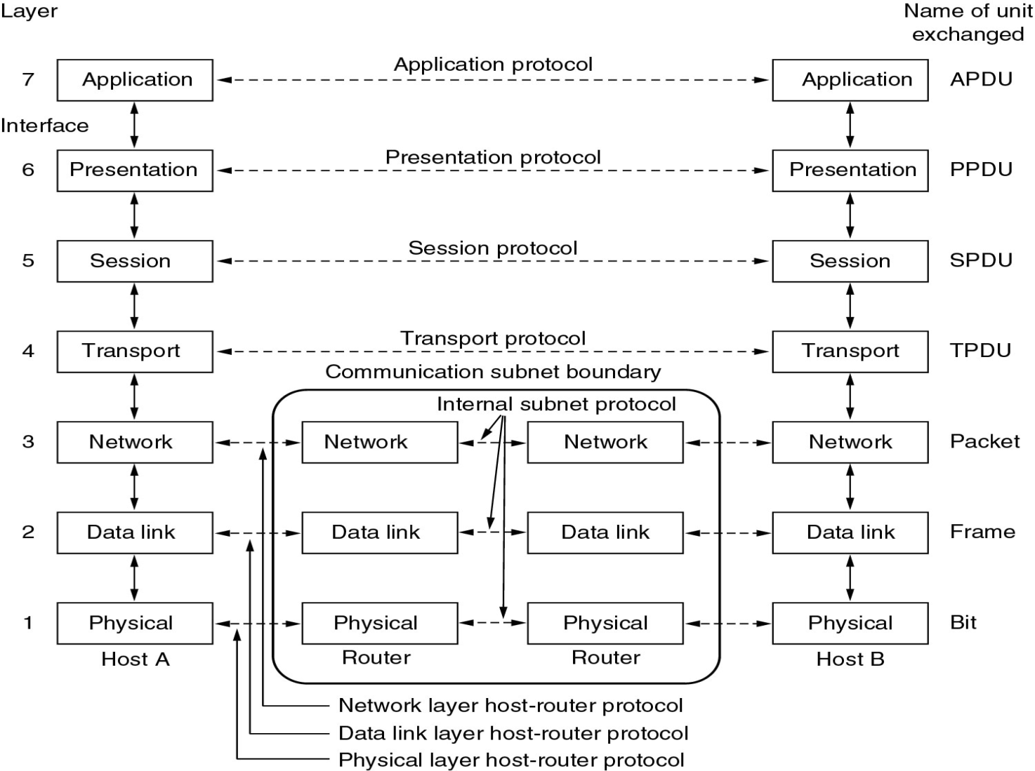
The OSI Reference Model
The OSI
reference
model.
1983,1995

Slide 169

Summary
Transmission mediums
Fiber optic
Wireless
Network categories:
Wide Area Networks
Local Area Networks
Wireless Networks
Internet
Origin
Key elements
Internet architecture
Trends challenging data communications:
Traffic growth
Development of new services
Advances in technology
Data Transmission and Network Capacity Requirements
Convergence
Notes:
Chapter 1summary.

